Slide 1
FOREX
By: Anna Pedroni, Kamsy Nwokedi, Freeman Fang & Alin Alzaidy

Slide 2
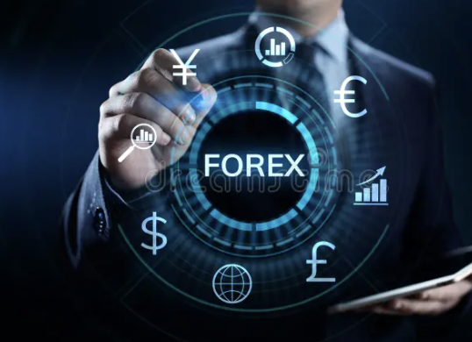
Introduction to forex
Forex, short for foreign exchange, is a global financial market where currencies are traded.
It serves as a platform for individuals, businesses, and institutions to exchange one currency for another.
Forex is used for various purposes, including international trade, investment, and speculation on currency price movements.

Slide 3
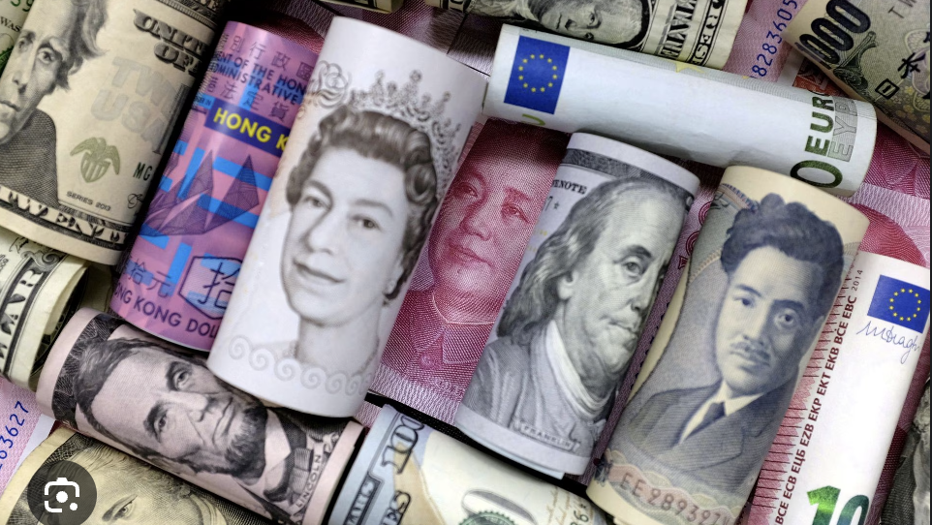
CURRENCY COMPARISONS
In this context, we'll compare exchange rates involving the British Pound (GBP) against the Euro (EUR), US Dollar (USD), Swiss Franc (CHF), and Hong Kong Dollar (HKD).

Slide 4
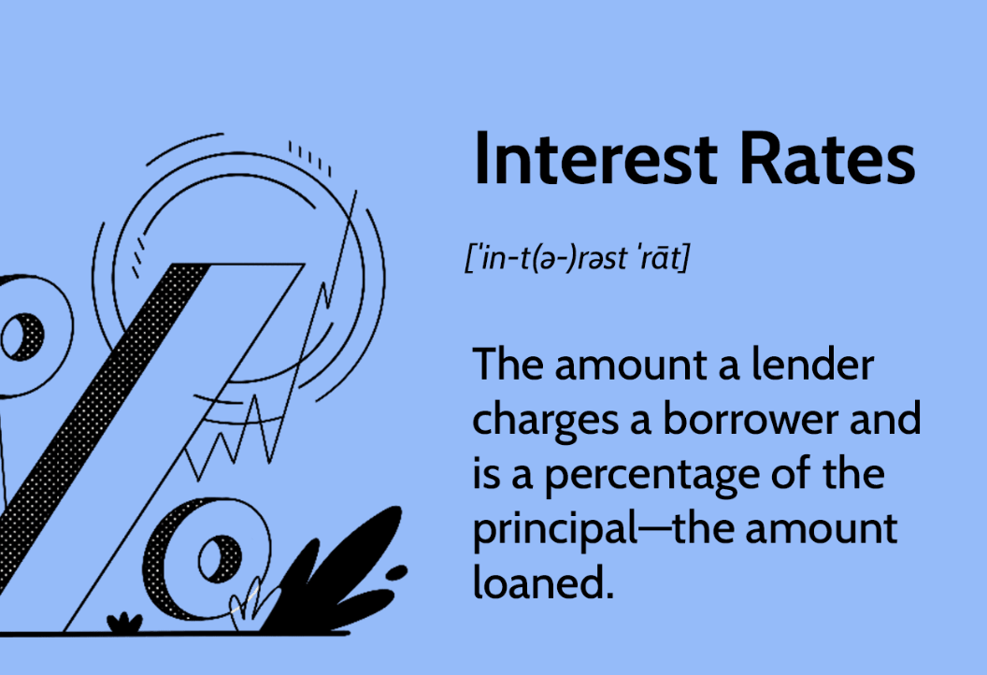
Interest rates
They are set by central banks to control inflation, stimulate or cool down economic activity, and influence the exchange rate by affecting the attractiveness of a currency for investors.
Accessing how forex rates affect interest rates in the Bank of England and the European Central Bank involves monitoring how currency fluctuations impact inflation and economic conditions, which in turn influence the central banks' decisions on lending rates.

